Slide 1
VR Project 2: Baseball Simulator
Roger Mendez & Chi Yuen Chan

Slide 2
Baseball Hitting Simulator
Creating an interactive baseball batting simulation game in VR
Allow the user to look around a 360 degree scene set in a baseball stadium
When triggered, a baseball will be thrown for the user to hit with a baseball bat
Show statistics on speed and distance of ball (extra)

Slide 3
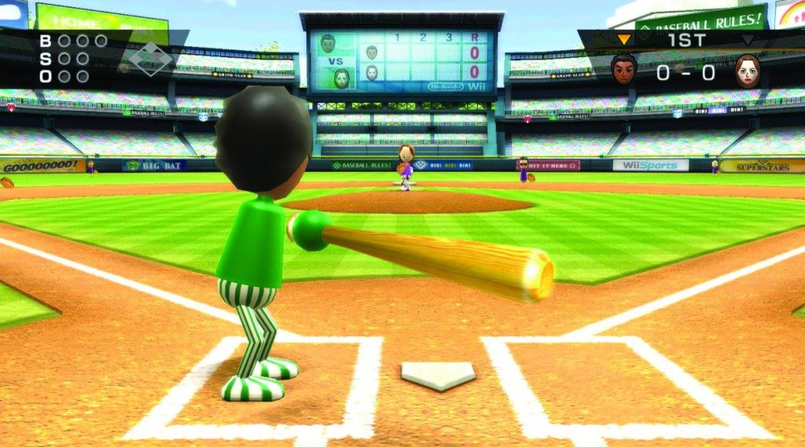
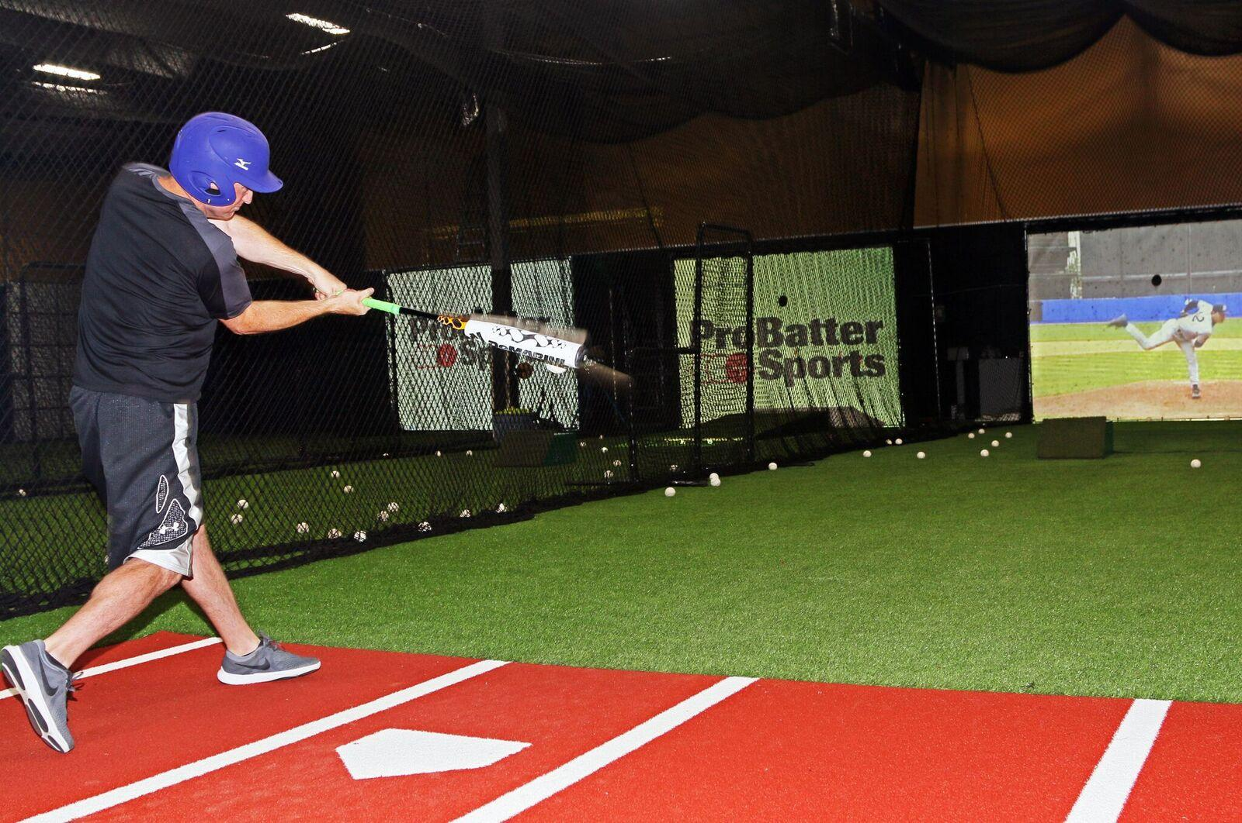
Why in VR?
This is an interactive game with collision that will allow people to do a physical activity without needing actual sports equipment
Less safety concerns
Gives an immersive experience compared to playing it on a computer or mobile device
Can feel realistic with easy at home practice

Slide 4
Environment and Interactions
Baseball stadium - allows the user to be in a realistic stadium that is to scale with a real stadium so it actually feels like they are playing
The interaction is not interactable, but there for the immersion
Baseball bat - will be in the users hands and can hit baseballs when thrown
Baseball - when triggered, will be thrown towards the user for them to swing their bat and hit them.
Depending on the contact, the ball will move different distances and places.
Uses lots of collision and physics
Ball being thrown, bat hitting ball, ball moving properly after hit.

Slide 5
Plan
Create a realistic environment
Add a baseball bat that is permanently in the users hands that will only collide with baseballs
Add a trigger to spawn a baseball to be thrown towards the user
Add physics and collision for when a ball is hit
Create a tracker for the user to see distance, speed, and other statistics on how the ball was hit. (EXTRA)
We will both take 50% of each component, and ideally have all the blend file done by the 20th and have basic physic down. We will implement the extra functionality if time permits.

